Slide 1
Artificial Neural Network (ANN)

Slide 2
Artificial Neutral Network (ANN)
ANN is a system that is based on the biological neural network, such as the brain.
The brain has approximately 100 billion neurons, which communicate through electro-chemical signals.
The neurons are connected through junctions called synapses.
Each neuron receives thousands of connections with other neurons, constantly receiving incoming signals to reach the cell body.
If the resulting sum of the signals above a certain threshold, a response is sent through the axon.
The ANN attempts to recreate the computational mirror of the biological neural network.

Slide 3
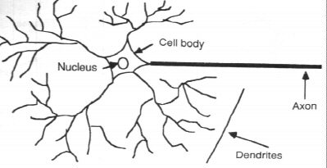
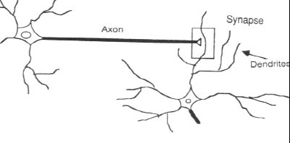

Slide 4
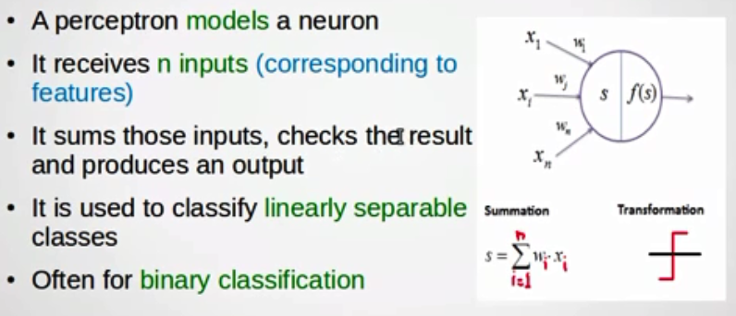
Perceptron (An Artificial Neuron)

Slide 5
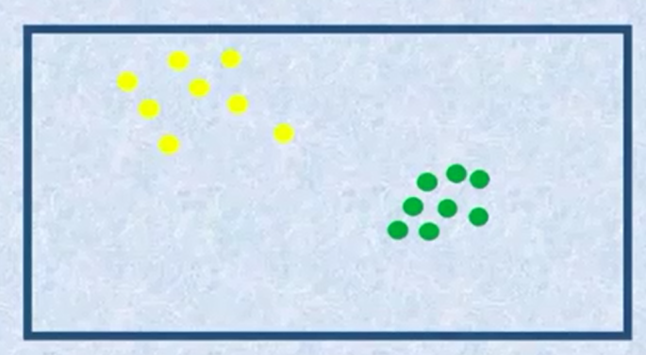
Neural Network and Classification

Slide 6
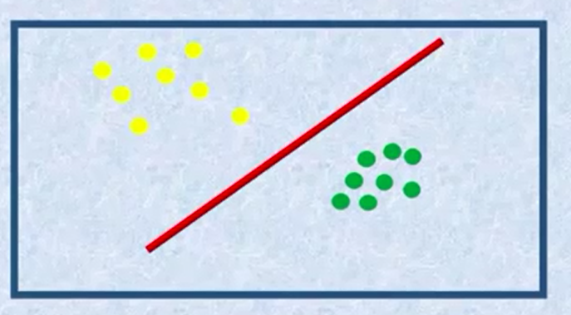
Linear Classifier

Slide 7
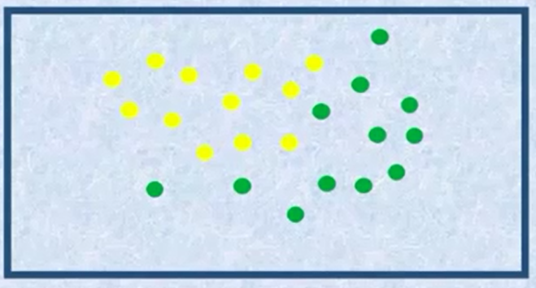
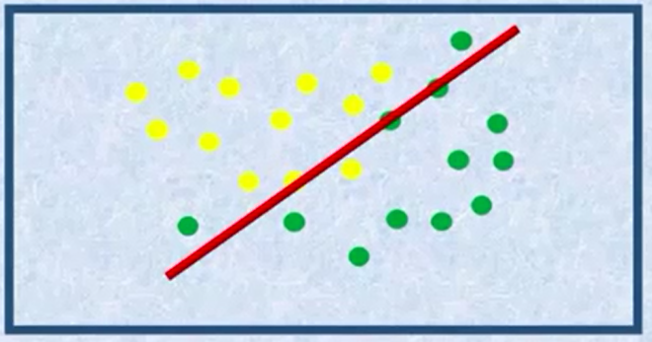
Linear Classifier - Complex Data (Non-Linear)

Slide 8
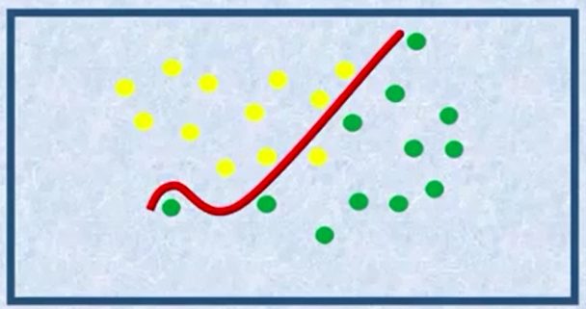
Non-Linear Classifier Neural Network Training Data
Epoch 1

Slide 9
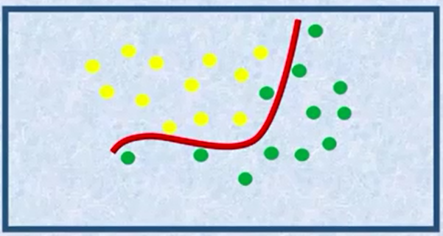
Epoch2

Slide 10
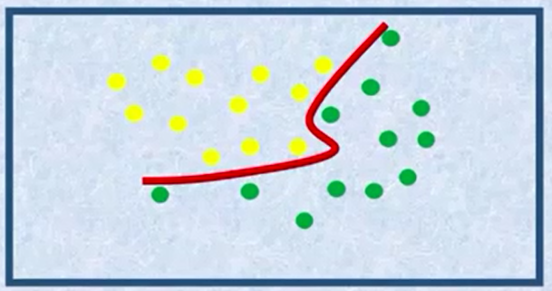
Epoch 3

Slide 11
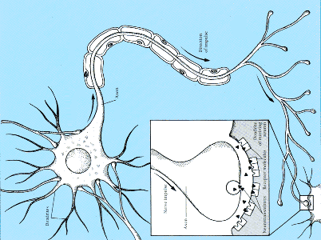
Input signals sent
from other neurons
If enough sufficient signals accumulate, the neuron fires a signal.
Connection strengths determine how the signals are accumulated

Slide 12
input signals ‘x’ and coefficients ‘w’ are multiplied
weights correspond to connection strengths
signals are added up – if they are enough, FIRE!
output signal
incoming signal
connection strength
activation
level
Notes:
12

Slide 13
Calculation…
Sum notation
(just like a loop from 1 to M)
if (activation > threshold) FIRE !
Notes:
13

Slide 14
The Perceptron Decision Rule
if
Notes:
14

Slide 15
if
output = 0
output = 1
Rugby player = 1
Ballet dancer = 0
Notes:
15

Slide 16
Is this a good decision boundary?
if
Notes:
16

Slide 17
w₁ = 1.0
w₂ = 0.2
t = 0.05
if
Notes:
17

Slide 18
w₁ = 2.1
w₂ = 0.2
t = 0.05
if
Notes:
18

Slide 19
w₁ = 1.9
w₂ = 0.02
t = 0.05
if
Notes:
19

Slide 20
w₁ = -0.8
w₂ = 0.03
t = 0.05
Changing the weights/threshold makes the decision boundary move.
Pointless / impossible to do it by hand – only ok for simple 2-D case.
We need an algorithm….
Notes:
20

Slide 21
Example
x1
x2
x3
w1
w2
w3
Q1. What is the activation, a, of the neuron?
Q2. Does the neuron fire?
Q3. What if we set threshold at 0.5 and weight #3 to zero?
Notes:
21

Slide 22
x1
x2
x3
x1
x2
x3
w1
w2
w3
w1
w2
w3
Q1. What is the activation, a, of the neuron?
Q2. Does the neuron fire?
if (activation > threshold) output=1 else output=0
…. So yes, it fires.
Notes:
22

Slide 23
x1
x2
x3
x1
x2
x3
w1
w2
w3
w1
w2
w3
Q3. What if we set threshold at 0.5 and weight #3 to zero?
if (activation > threshold) output=1 else output=0
…. So no, it does not fire..
Notes:
23

Slide 24
We need a more sophisticated model…
The Perceptron
height
weight
Notes:
24

Slide 25
The Perceptron
Decision boundary
height
height
weight
weight
, and change the position of the DECISION BOUNDARY
Notes:
25

Slide 26
The Perceptron
Model
Error function
Learning algo.
height
weight
Notes:
26

Slide 27
Perceptron Learning Rule
new weight = old weight + 0.1 ( trueLabel – output ) input
update
What weight updates do these cases produce?
if… ( target = 0, output = 0 ) …. then update = ?
if… ( target = 0, output = 1 ) …. then update = ?
if… ( target = 1, output = 0 ) …. then update = ?
if… ( target = 1, output = 1 ) …. then update = ?
Notes:
27

Slide 28
Learning algorithm for the Perceptron
initialise weights to random numbers in range -1 to +1
for n = 1 to NUM_ITERATIONS
for each training example (x,y)
calculate activation
for each weight
update weight by learning rule
end
end
end
Perceptron convergence theorem:
If the data is linearly separable, then application of the Perceptron learning rule will find a separating decision boundary, within a finite number of iterations
Notes:
28

Slide 29
New data…. “non-linearly separable”
height
Our model does not match the problem!
(AGAIN!)
weight
Many mistakes!
Notes:
29

Slide 30
Multilayer Perceptron
x1
x2
x3
x4
x5
Notes:
30

Slide 31
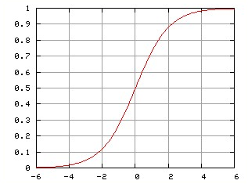
Sigmoid activation – no more thresholds needed ☺
Notes:
31

Slide 32
MLP decision boundary – nonlinear problems, solved!
height
weight
Notes:
32

Slide 33
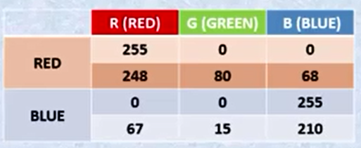
Simple Neural network Classification Example

Slide 34
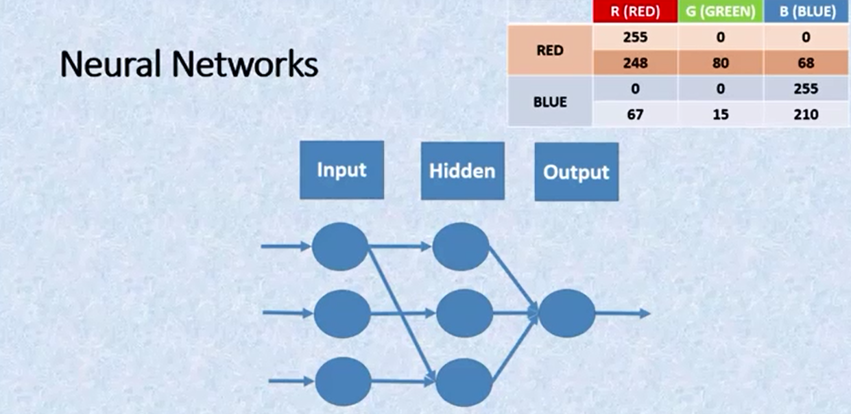
Network Architecture

Slide 35
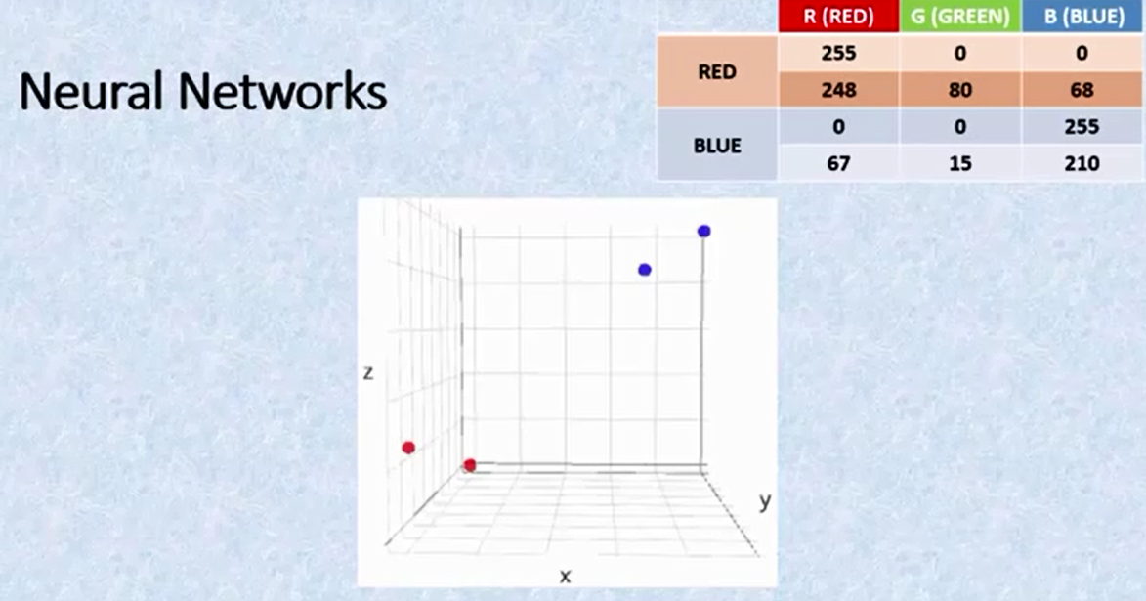

Slide 36
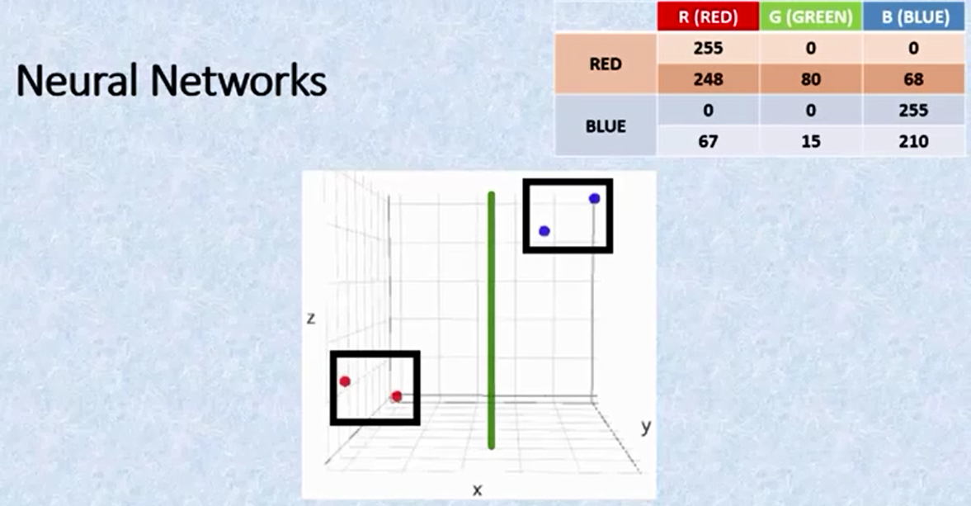

Slide 37
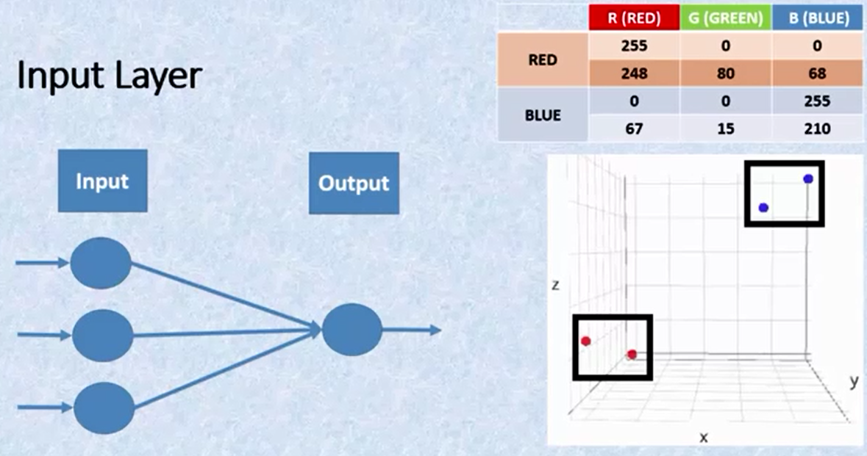

Slide 38
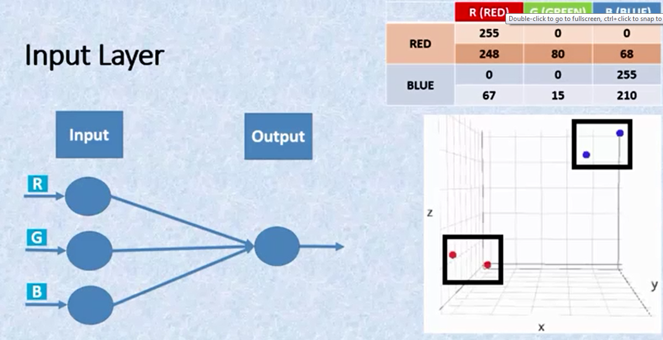
Input Layer

Slide 39
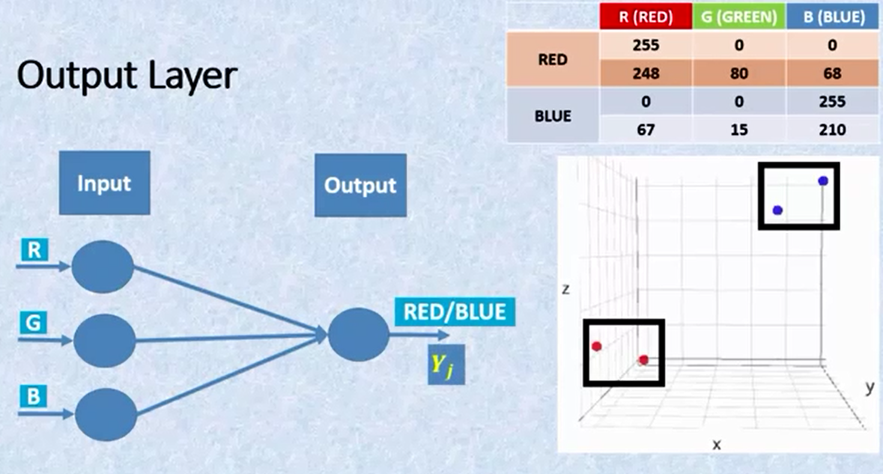
Output Layer

Slide 40
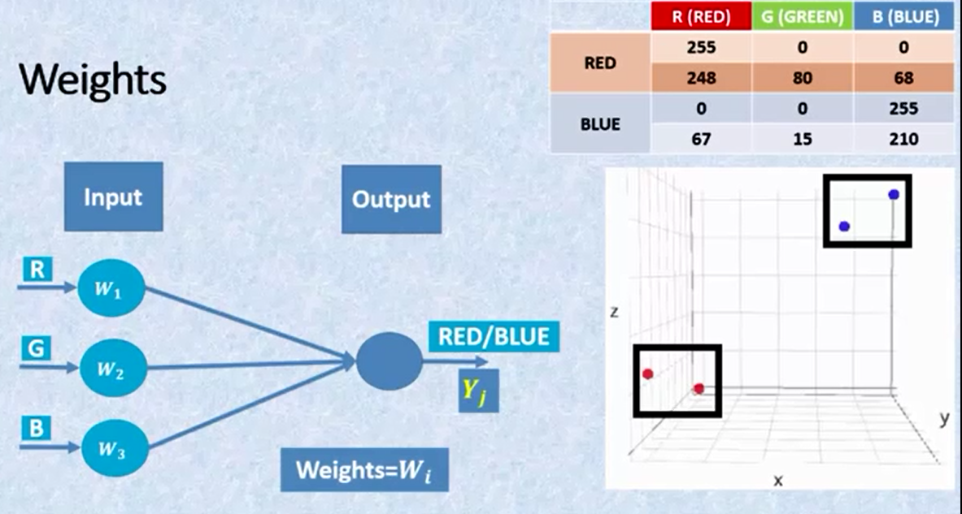
Weights

Slide 41
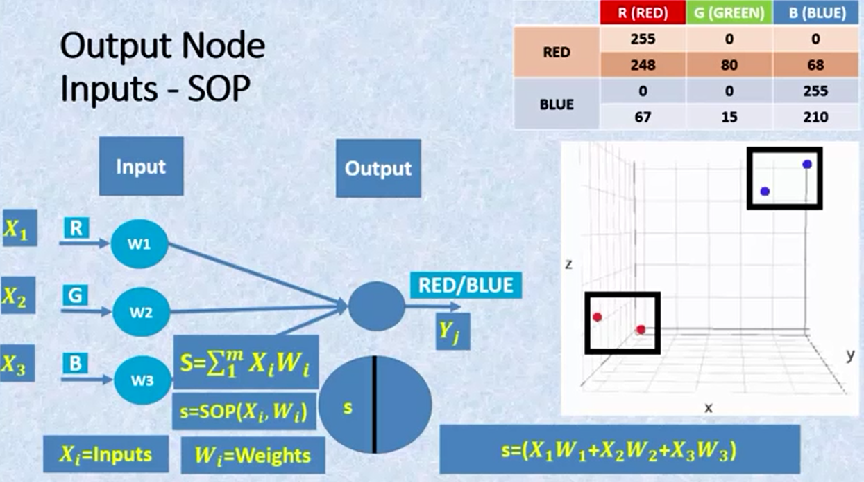
Mapping between I/O

Slide 42
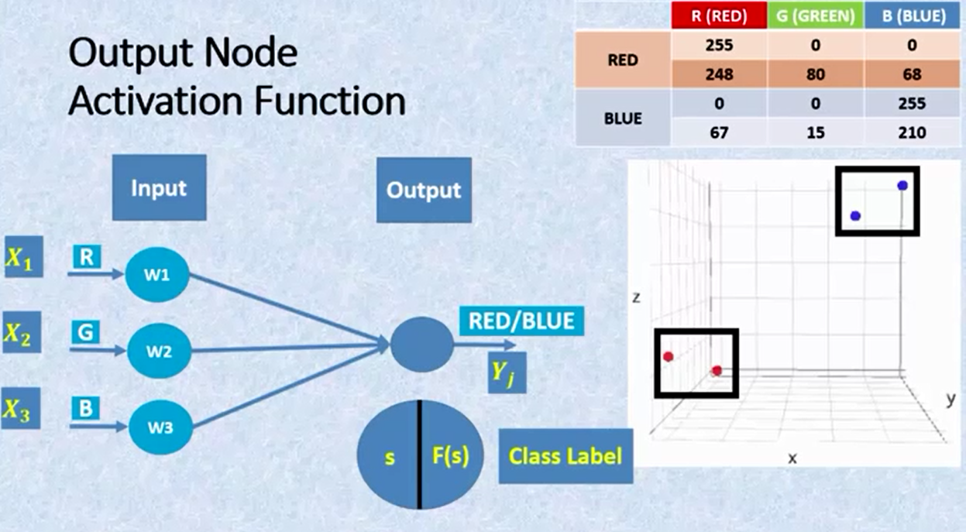
Activation Function

Slide 43
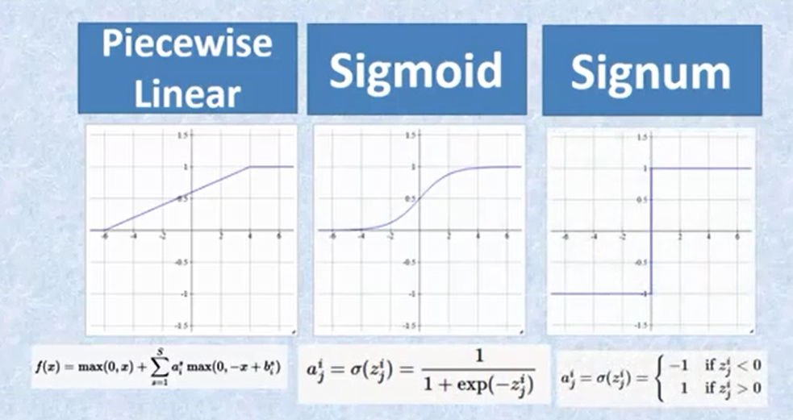
Activation Function Types

Slide 44
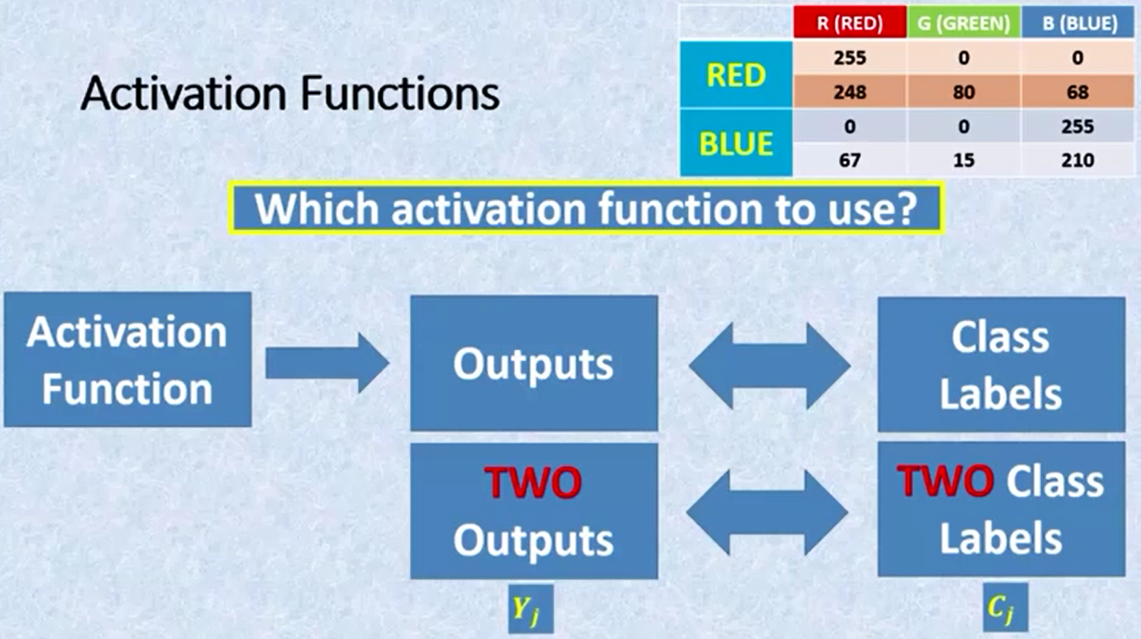

Slide 45
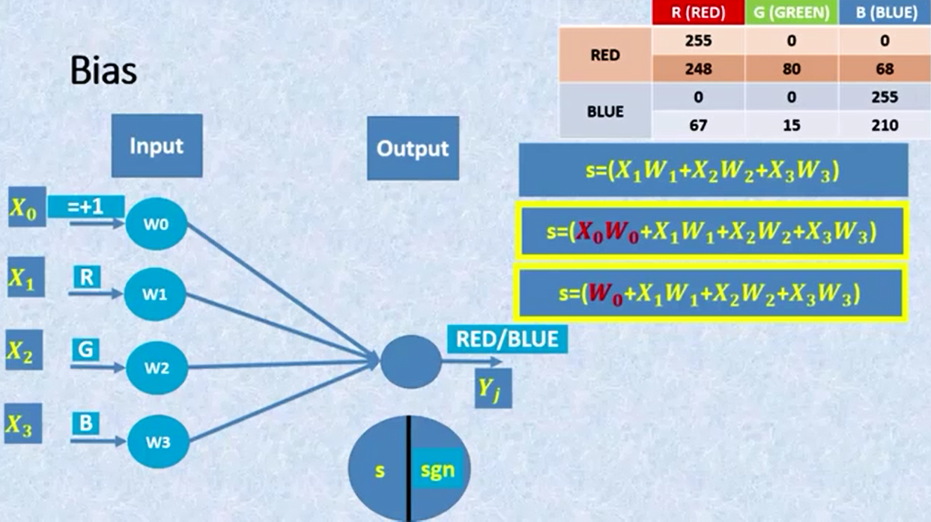
Bias

Slide 46
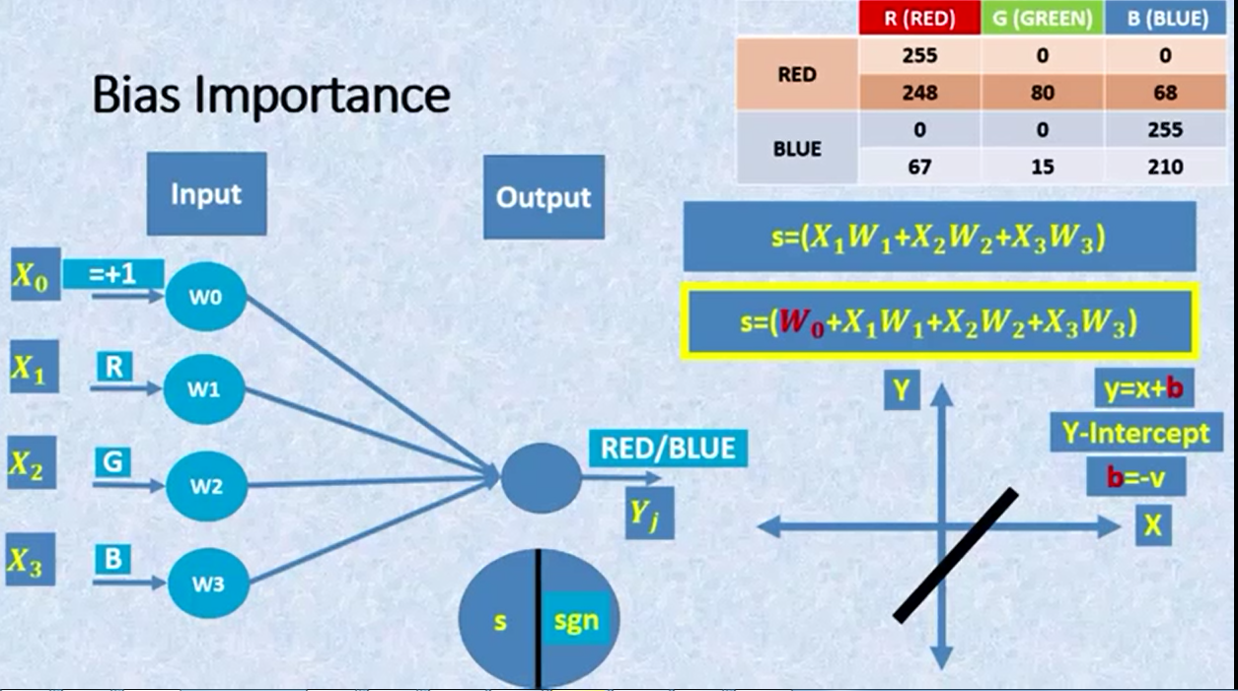
Bias Importance

Slide 47
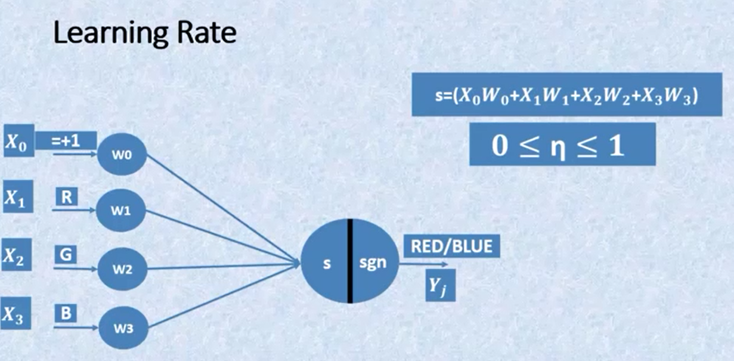
Learning Rate

Slide 48
Neural Network Parameters
Input Neurons + Bias
Weights + Bias Weight
Sum of product (SOP)..s
Activation Function (sgn)
Output (Yj)…..>Actual class
Learning Rate
Step n [0,1,2,3,….etc]
Desired Output (dj)

Slide 49
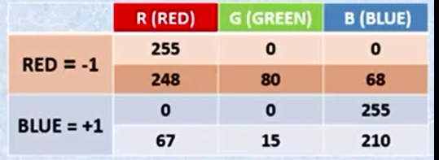
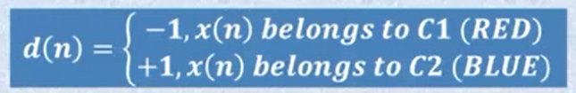
Desired Output

Slide 50
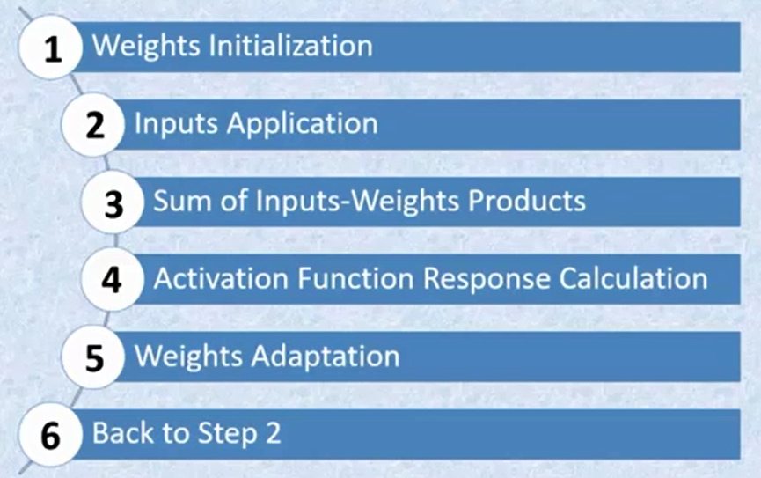
NN training steps

Slide 51
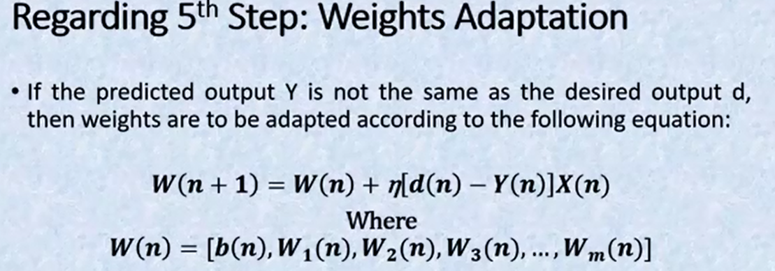

Slide 52
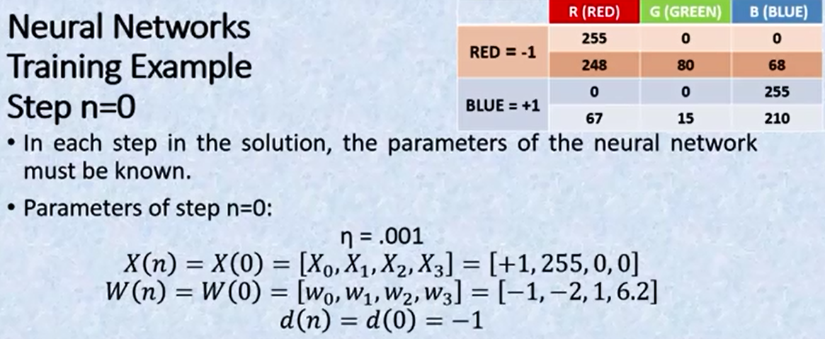

Slide 53
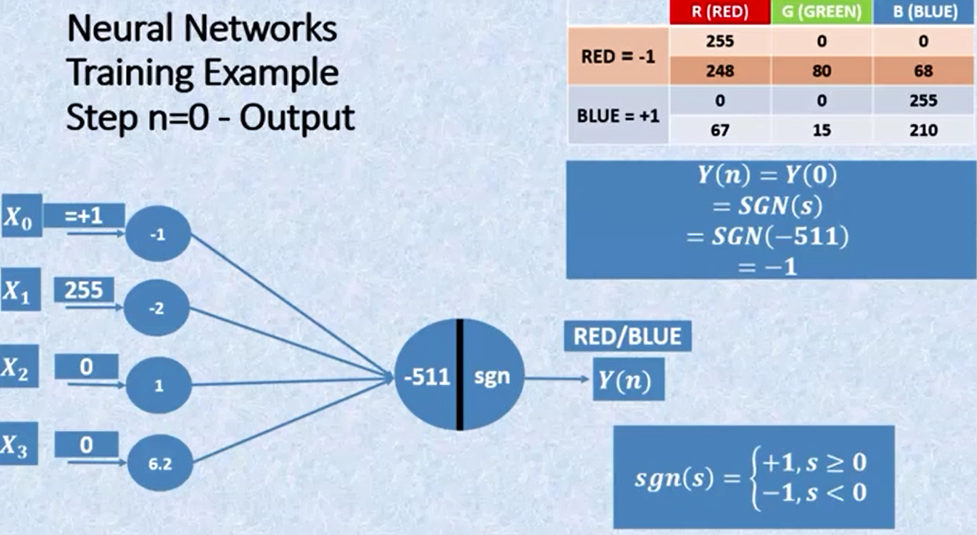

Slide 54
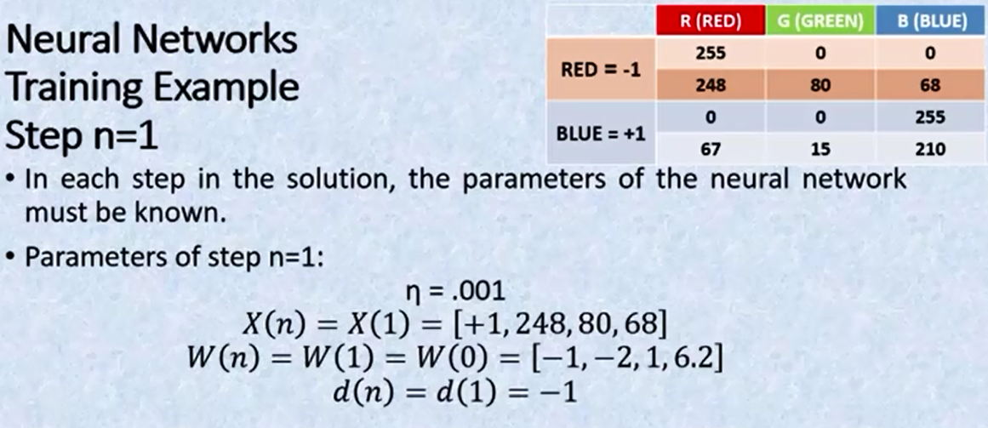

Slide 55
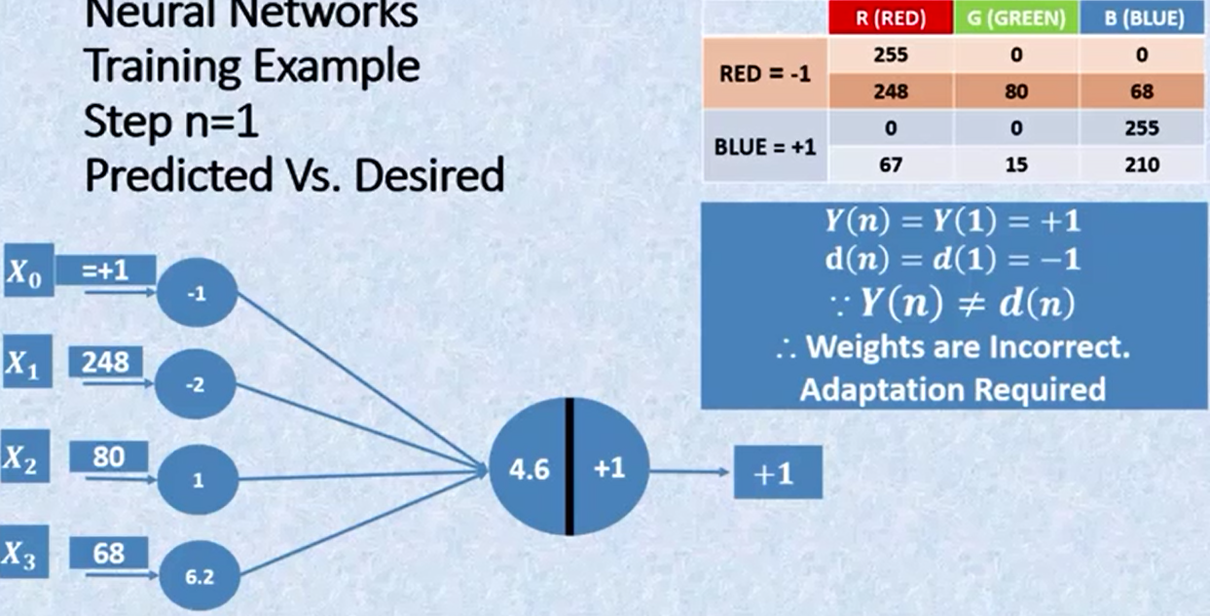

Slide 56
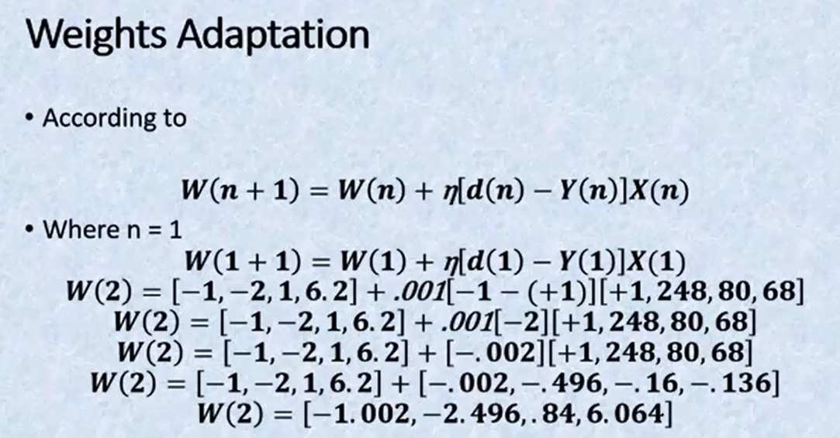

Slide 57
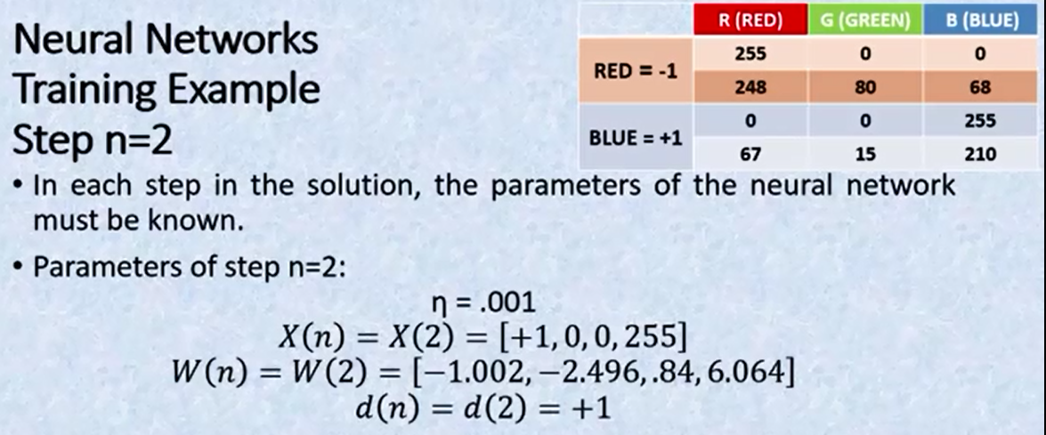

Slide 58
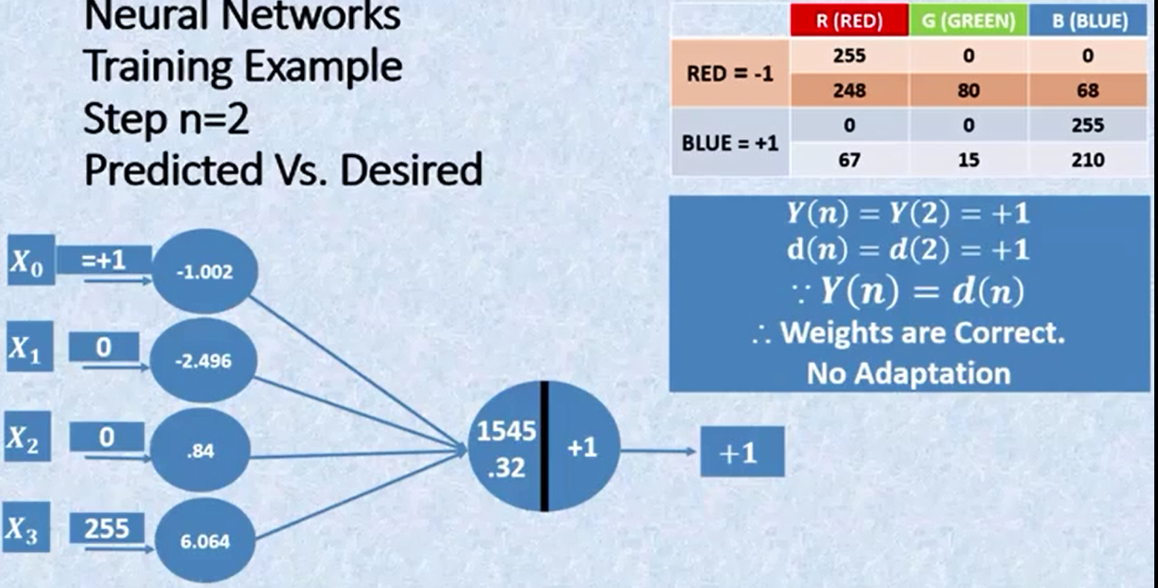

Slide 59
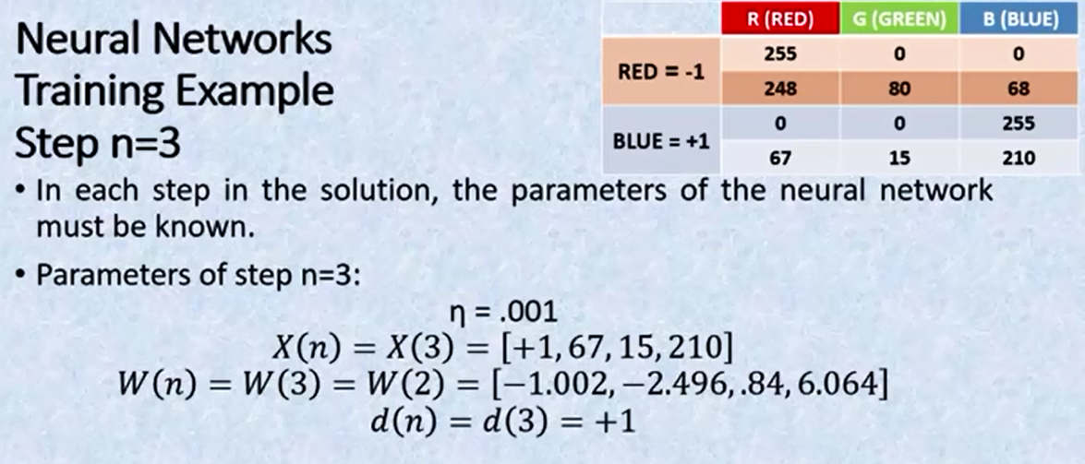

Slide 60


Slide 61
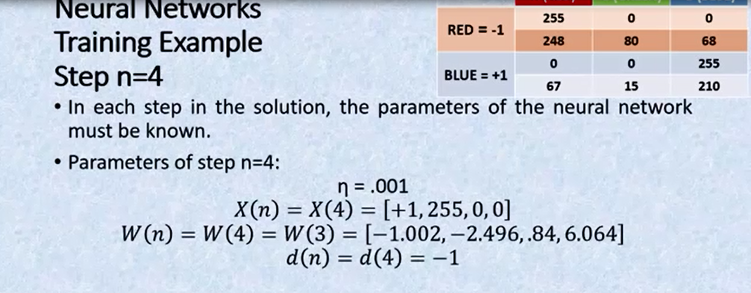

Slide 62


Slide 63
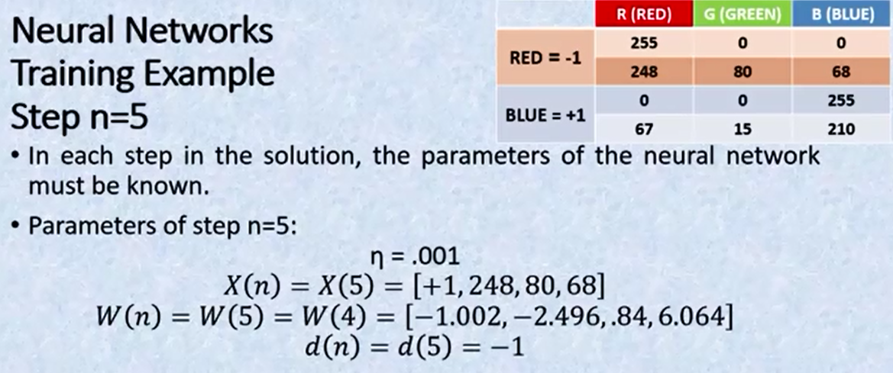

Slide 64
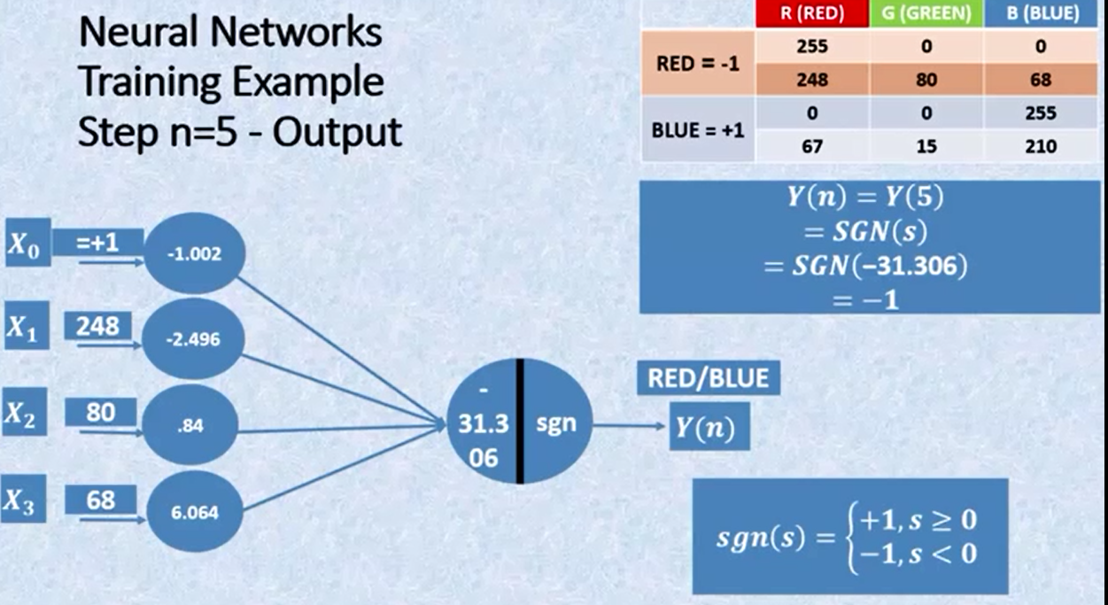

Slide 65
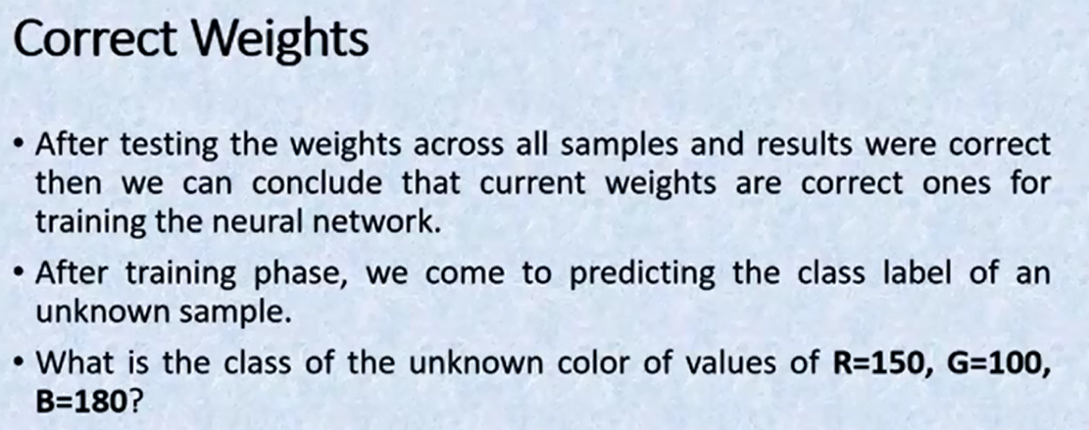
Generalization Test case

Slide 66
